Slide 1
RQVX CFD Efforts
7 April 2017
Austin Buscher, Capt, USAF
Aero Validation Branch
AFRL/RQVX

Slide 2
Capabilities
Provide quick-turnaround simulation of aerodynamic phenomena to decrease risk and increase intuition in support of RQVX Wind Tunnel tests.
Current Capabilities
2D and 3D Freestream flow at Mach=0.05 – 3.0
Rakes, wings, full aircraft, etc.
Model in SARL at Mach=0.1 – 0.5
Floor mounted with mixed success
Model in TGF at Mach=0.2 – 0.8
Running “in-tunnel” CFD much more computationally intensive
Future Capabilities
Model in VWT
TGF at supersonic Mach (need geometries of nozzle blocks)
Project Duration time (assuming half-time work from engineer)
2D Freestream: 1 week
3D Freestream: 2 weeks
3D “in-tunnel”: 1 month

Slide 3
Ongoing and Completed Projects
12 Projects from 2014-2017
[FS, VWT] Solid Wing (briefed SATA/STAI)
[FS] Ogive Shock Reflections
[TGF] Ogive Subsonic Blockage
[FS] Compliant Wing
[FS] Endplate Effectiveness
[SARL] Laminar Wing
[FS] SARL Rake 1
[FS] SARL Rake 2
[FS] VWT Rake
[FS] Five-Hole Probe (ongoing)
[FS] TGF Rake
[FS] RAWS Blockage Drag Estimate
First word indicates the tunnel used (internal flow) or freestream (external flow)
Abbreviations:
FS: Freestream
TGF: Trisonic Gasdynamic Facility
SARL: Subsonic Aerodynamic Research Lab
VWT: Vertical Wind Tunnel

Slide 4
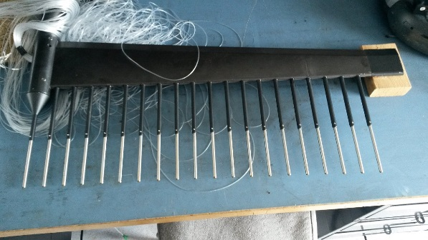
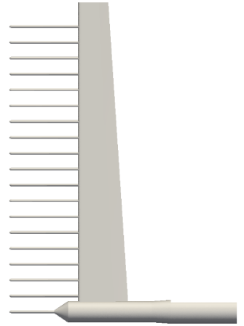
SARL Rake 1: Setup
Customer: O’Diam
Engineer: Buscher/Keane/Chang
Objective:
Assess the rake’s aerodynamic influences pressure profiles across the length of the rake
Compare to AEDC CFD and SARL data (to validate CFD)
Compare old and new rake data

Slide 5
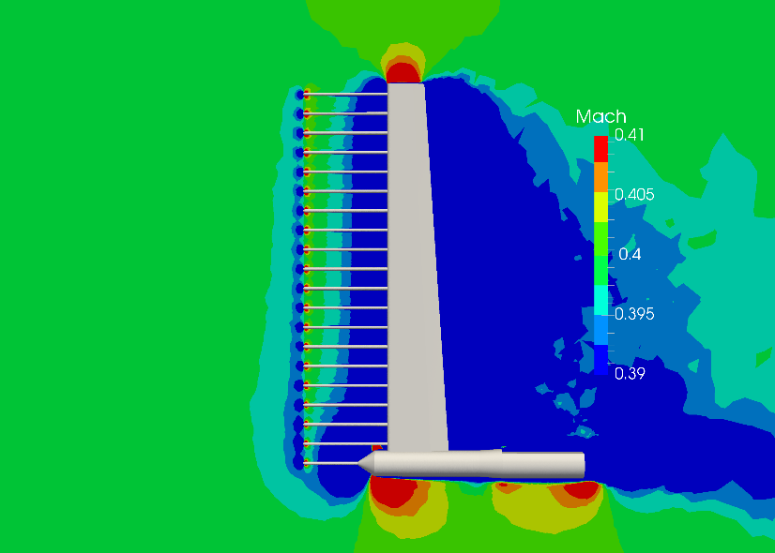
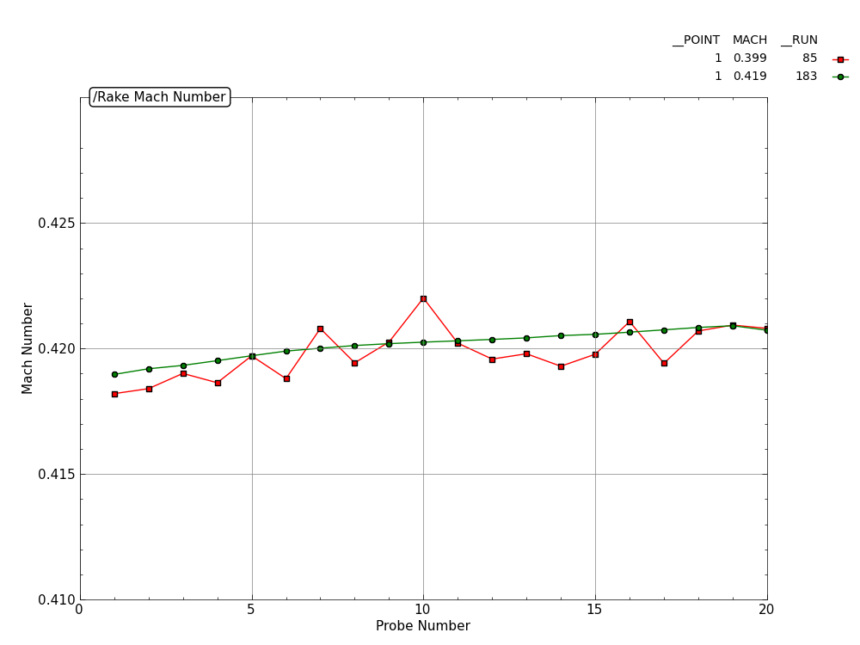
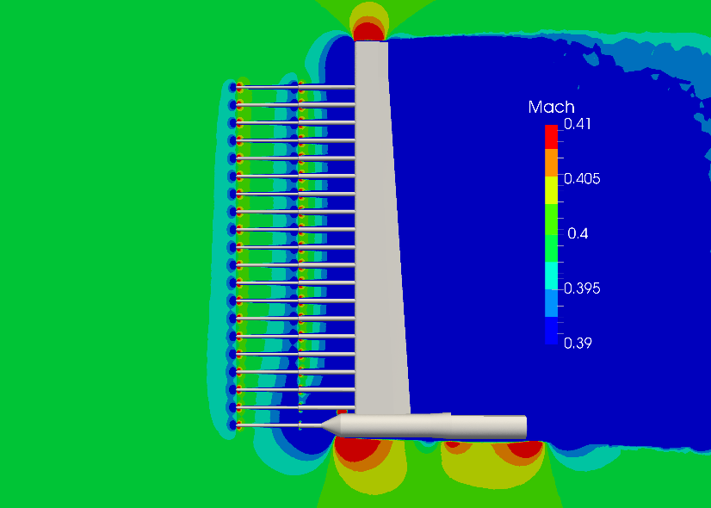
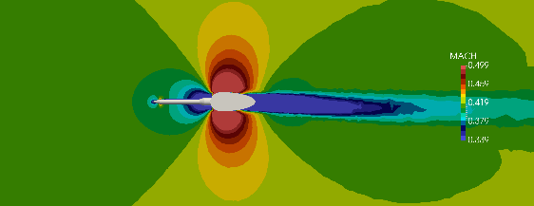
SARL Rake 1: Results
Determined significant aero impact from rake
Aided in design of new rake
Closely matches wind tunnel data
Supports suspicion of Mach number calculation errors in tunnel
Old Rake
CFD
New Rake
Tunnel
Very Old Rake

Slide 6
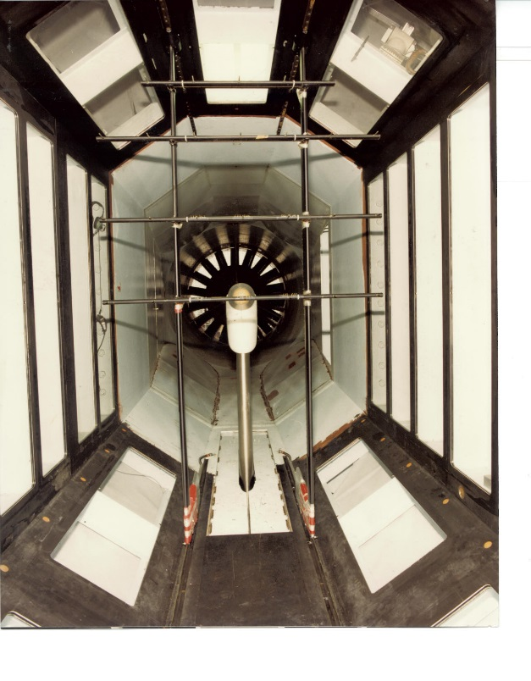
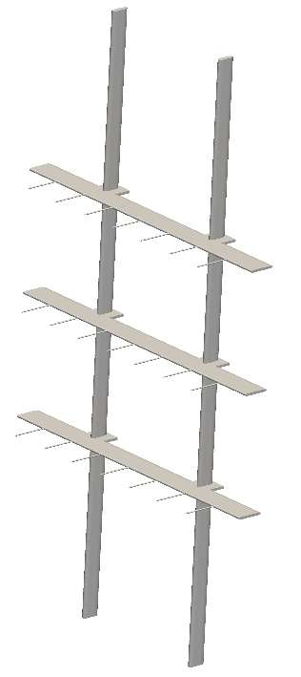
SARL Rake 2: Setup
Customer: O’Diam
Engineer: Buscher
Objective:
Determine suitability of Rake setup for determining flow uniformity in tunnel

Slide 7
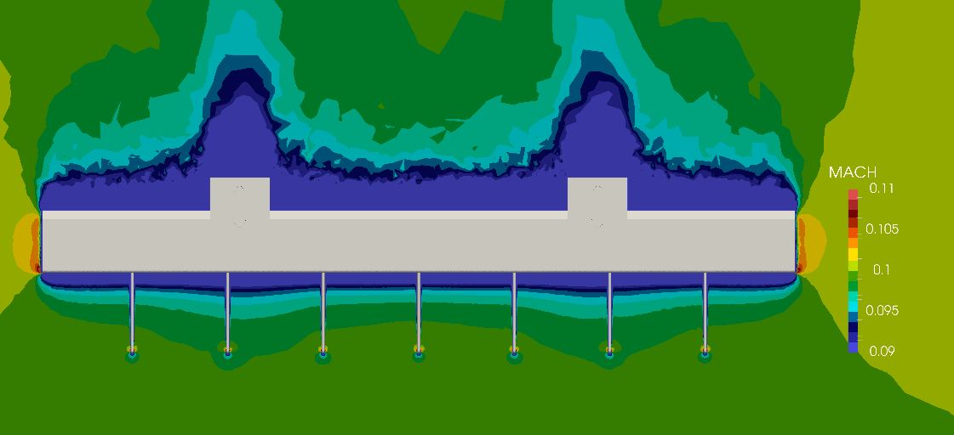
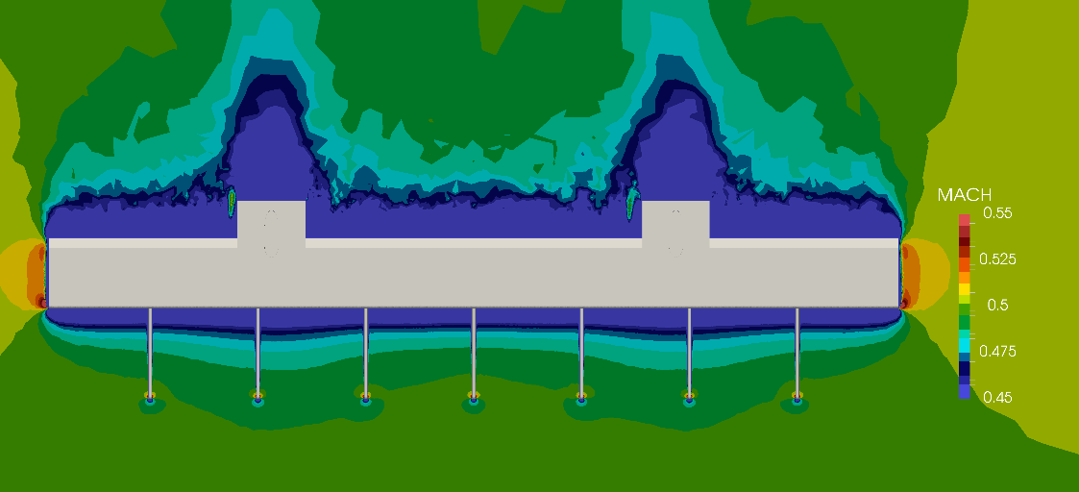
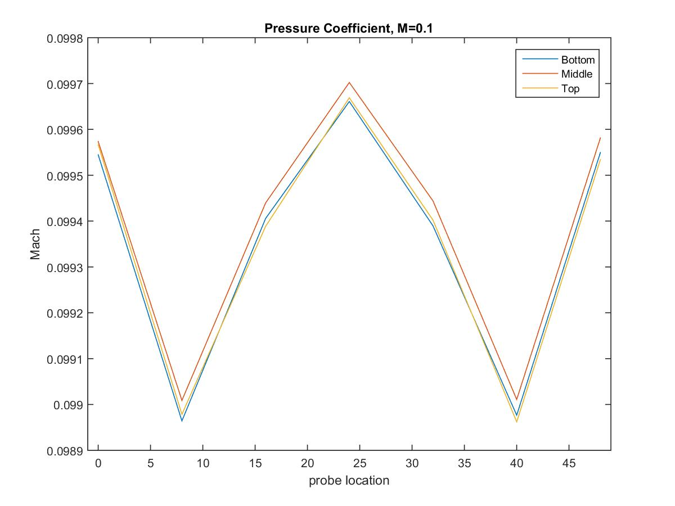
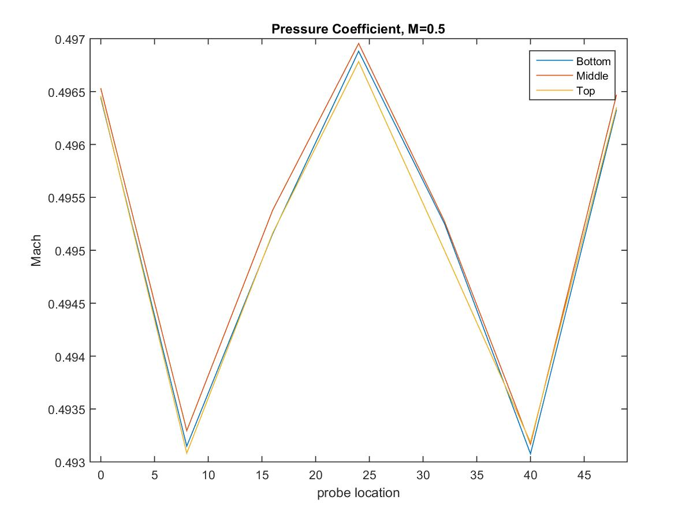
SARL Rake 2: Results

Slide 8
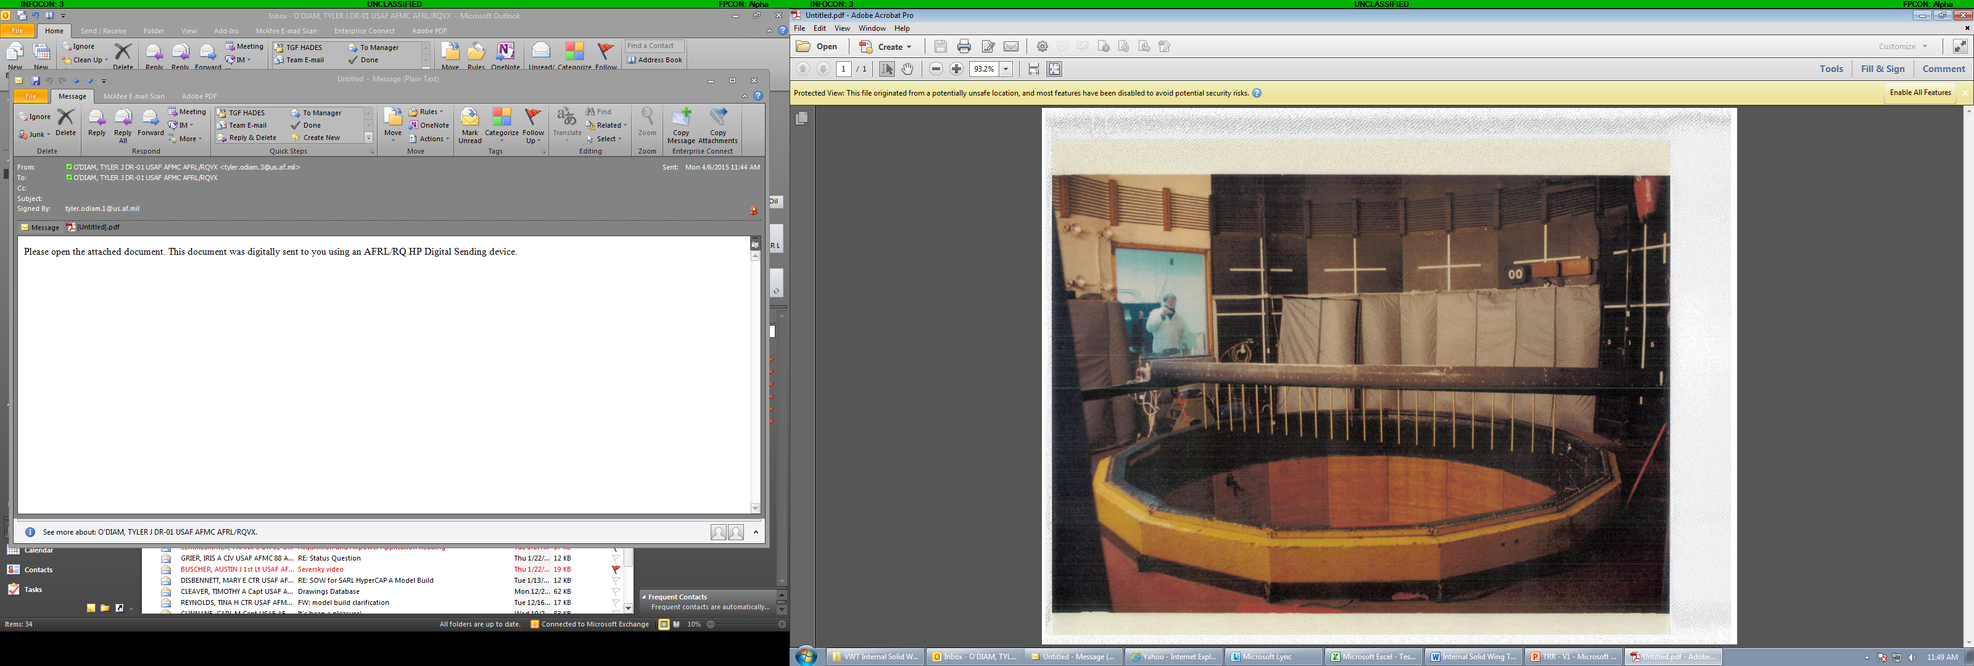
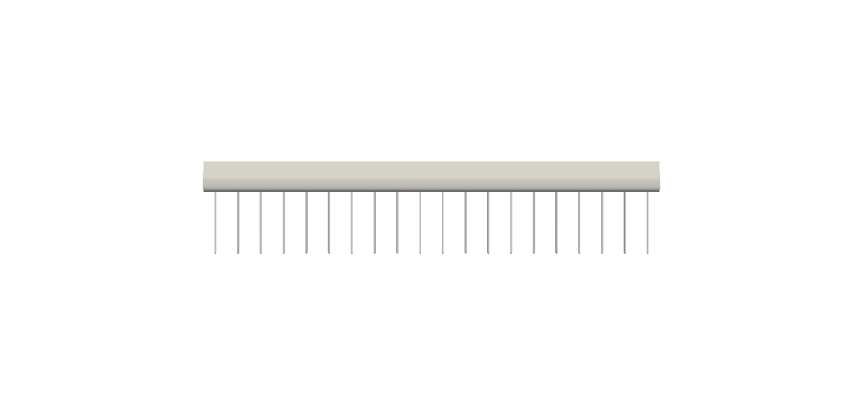

VWT Rake: Setup
Customer: Chang
Engineer: Keane
Objective:
Assess the rake’s aerodynamic influences
Compare experimental data in the SARL to the CFD data we obtained

Slide 9
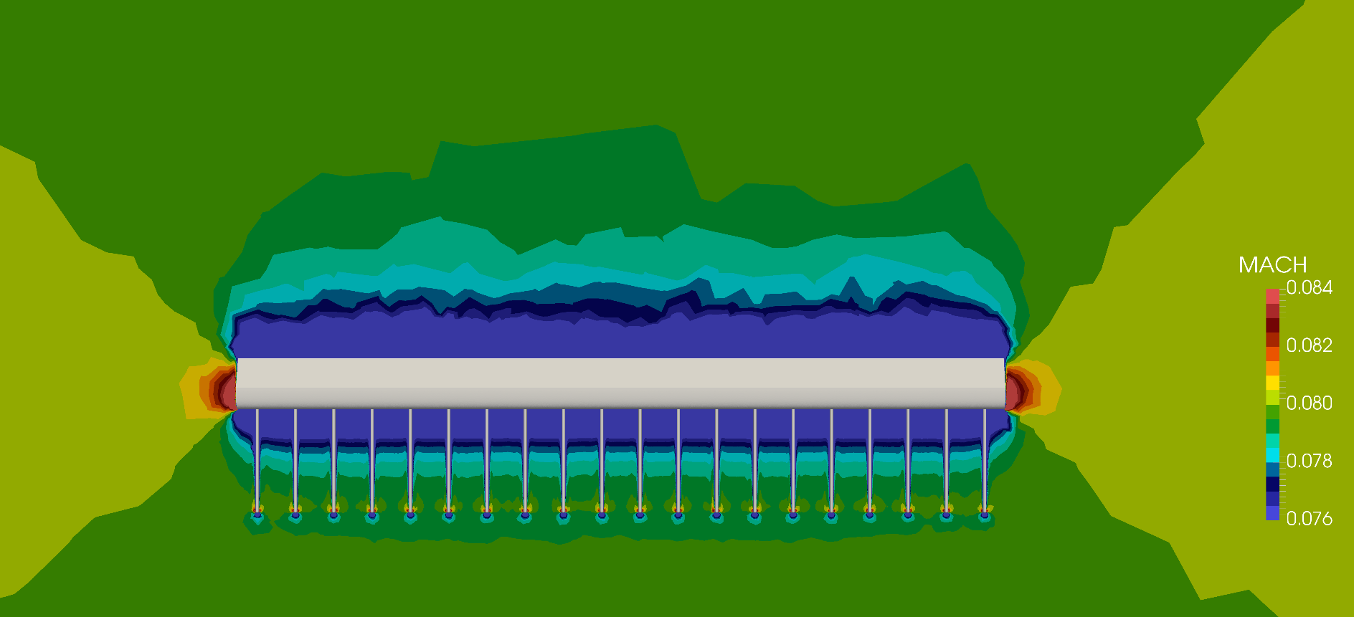
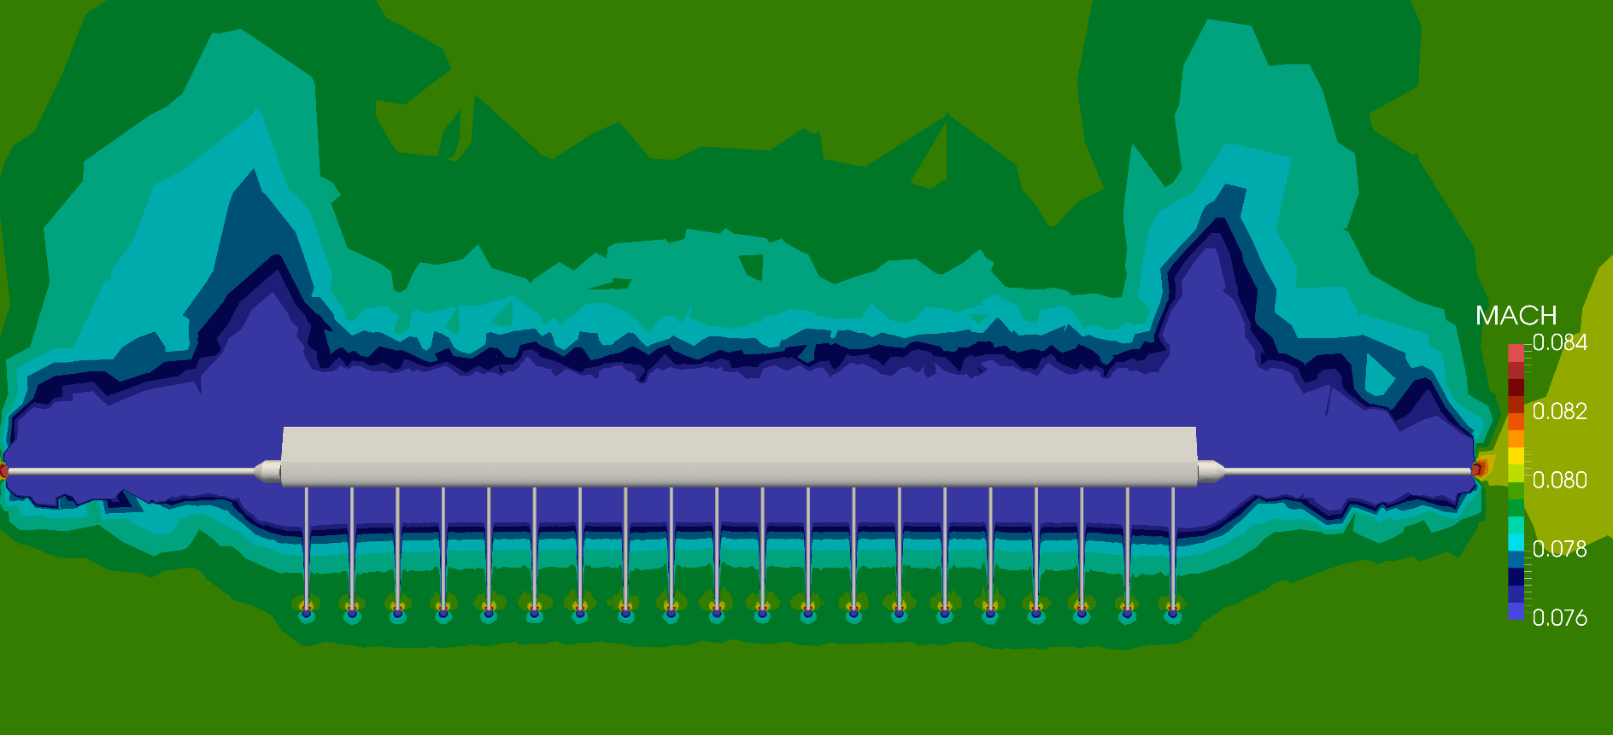
VWT Rake: Results

Slide 10
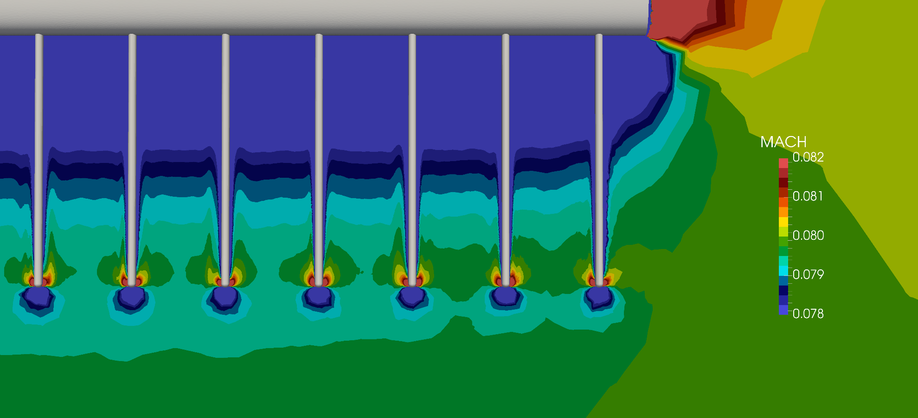
VWT Rake: Results

Slide 11

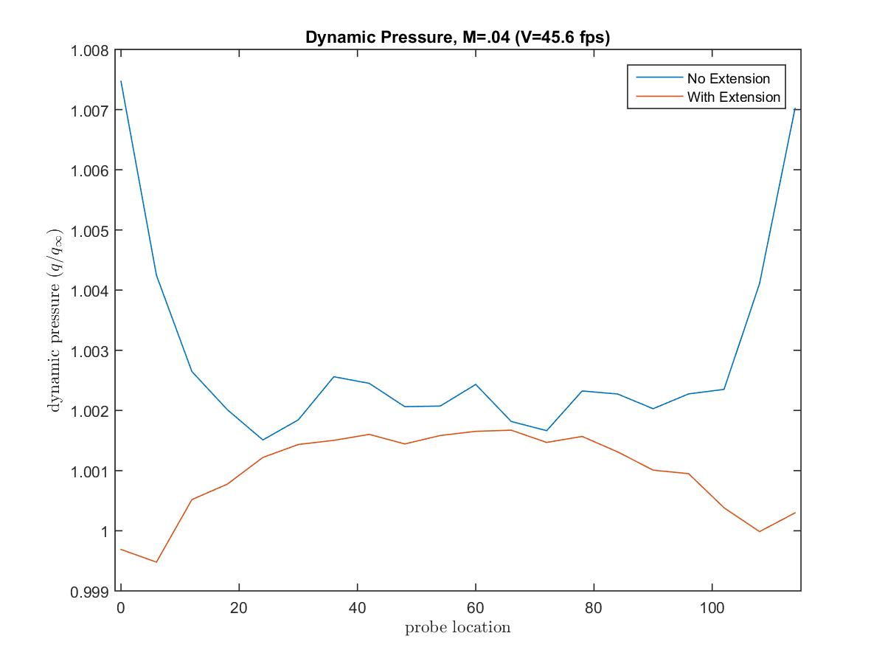
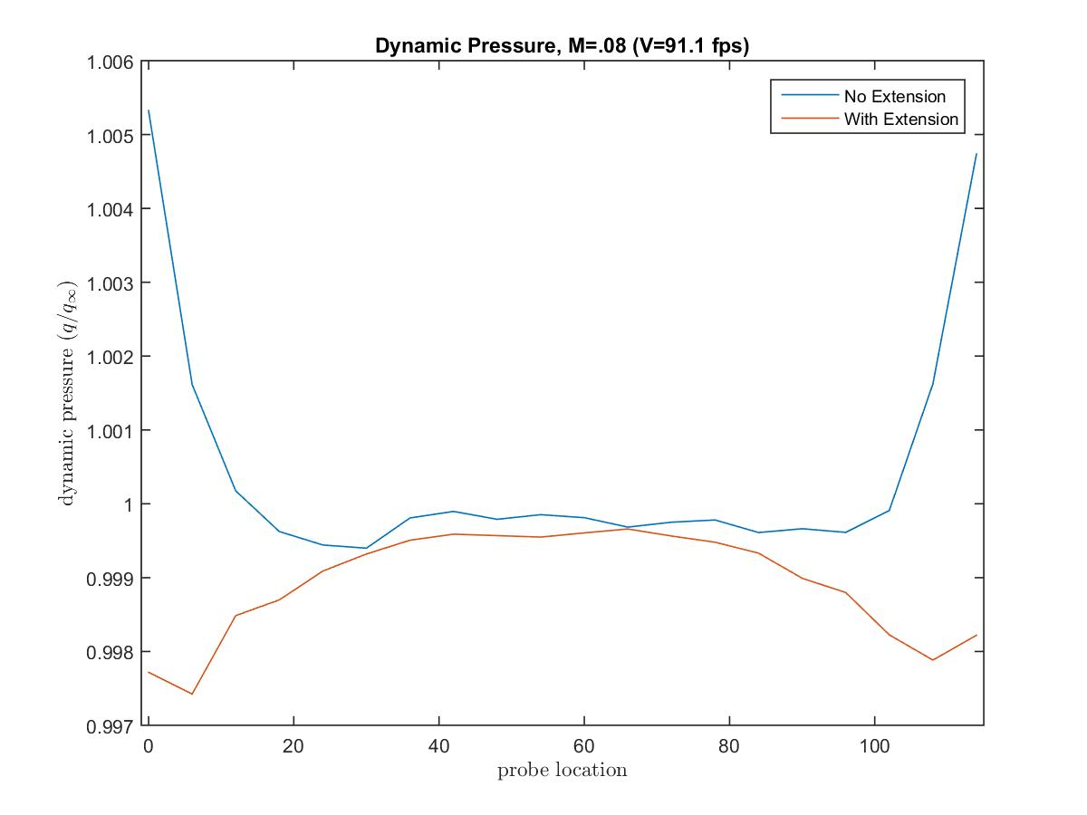
VWT Rake: Results

Slide 12
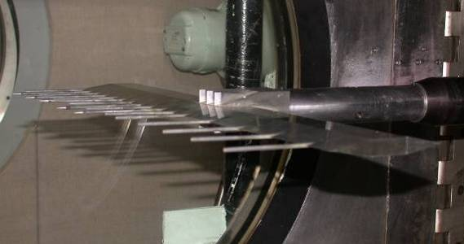
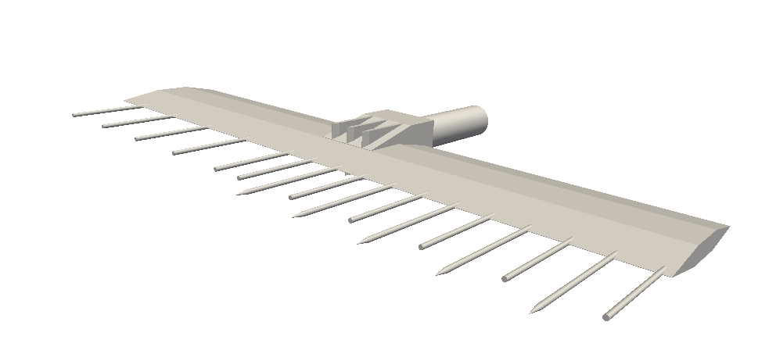
TGF Rake: Setup
Customer: Semmelmayer
Engineer: Buscher
Objective:
Investigate “reverse boundary layer” that concerned PE during the TGF Checkout (May 2016)

Slide 13
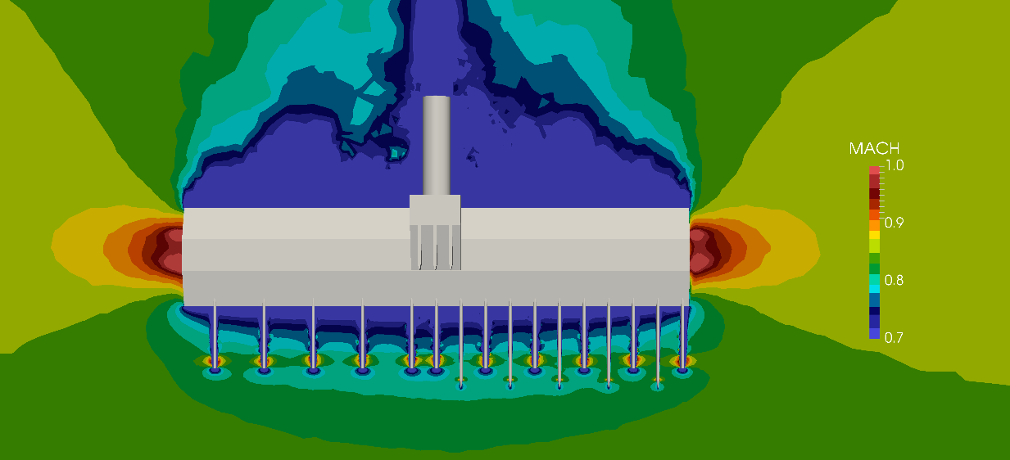
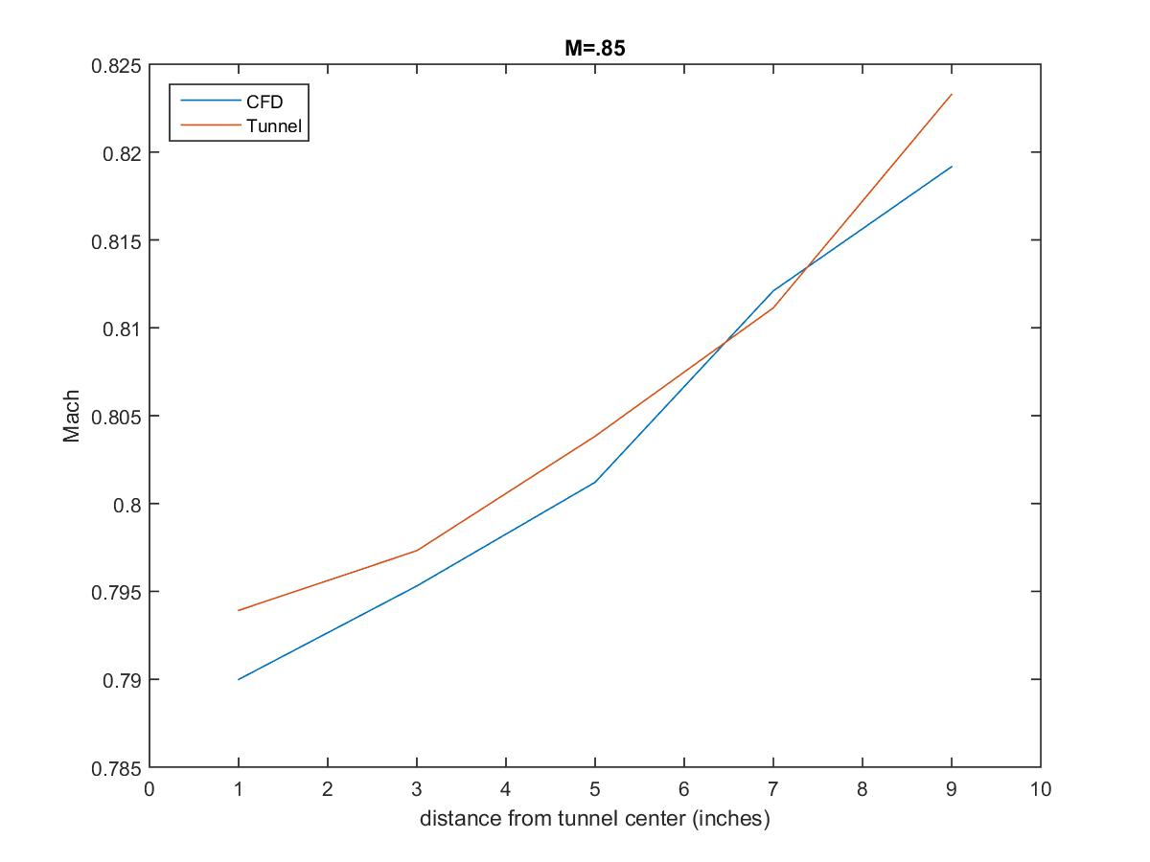
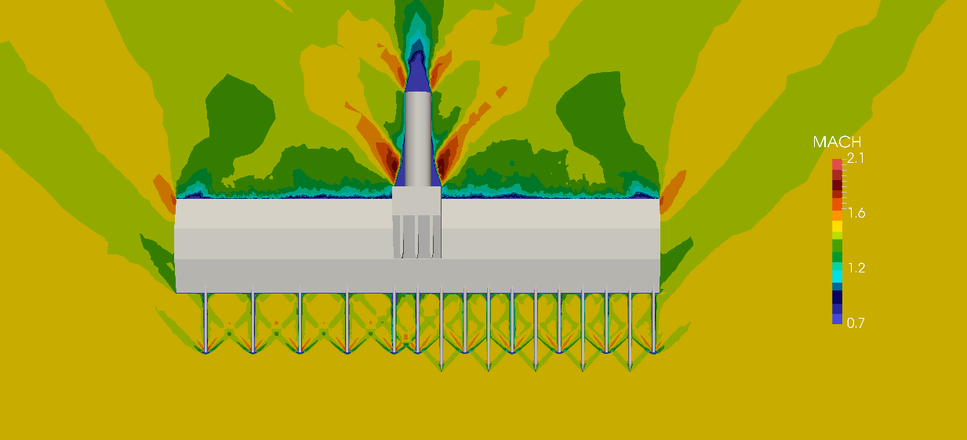
TGF Rake: Results

Slide 14

TGF Rake: Results

Slide 15
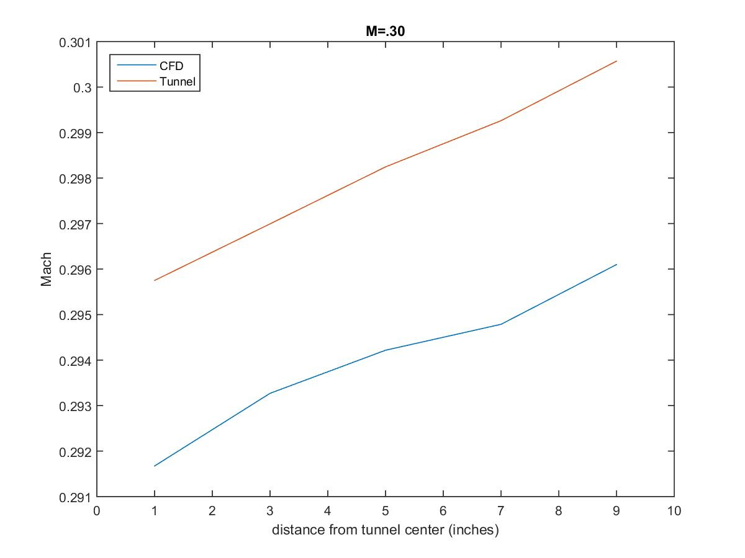
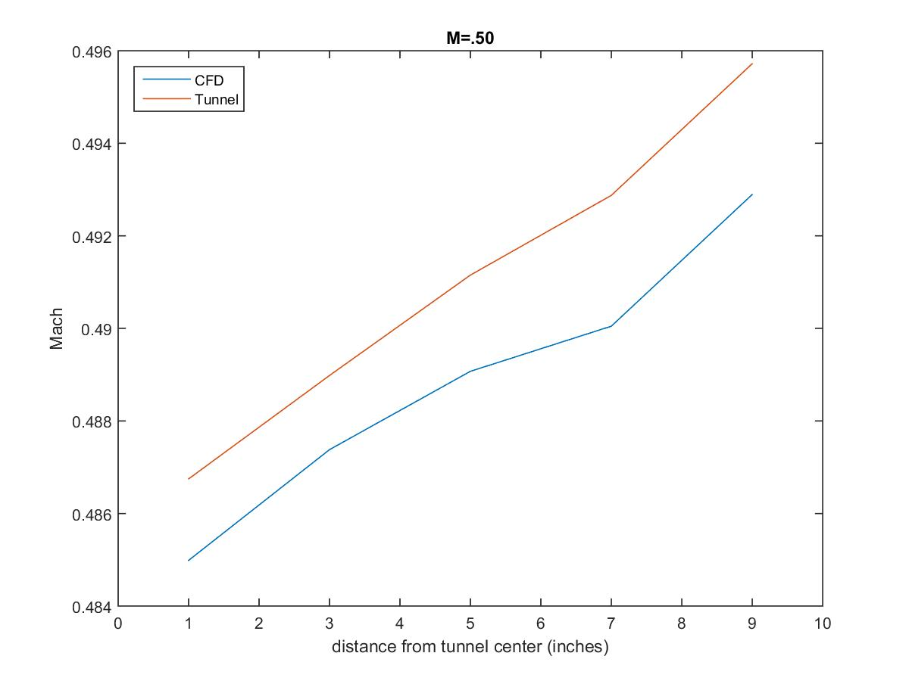
TGF Rake: Results

Slide 16
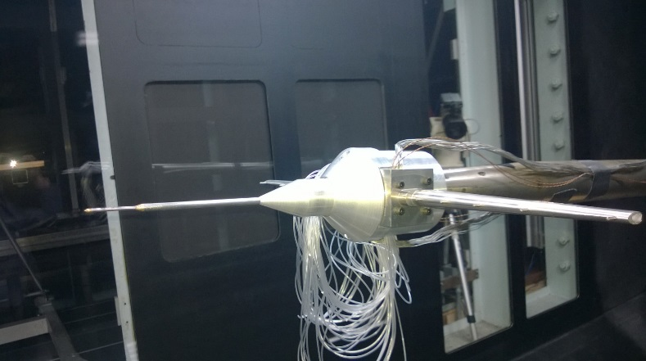
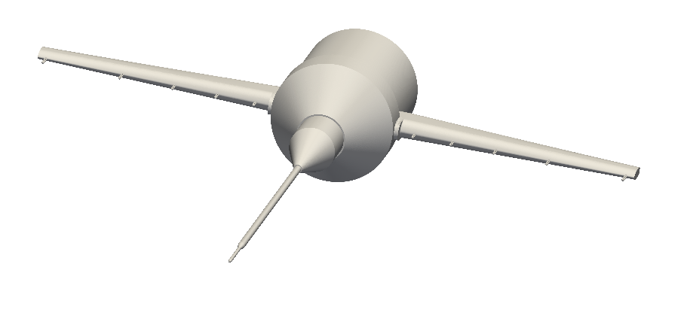
Five-Hole Probe: Setup
Customer: Semmelmayer
Engineer: Chang/Buscher
Objective:
Determine “bias” caused by addition of cone in calibration of 5-hole probes

Slide 17
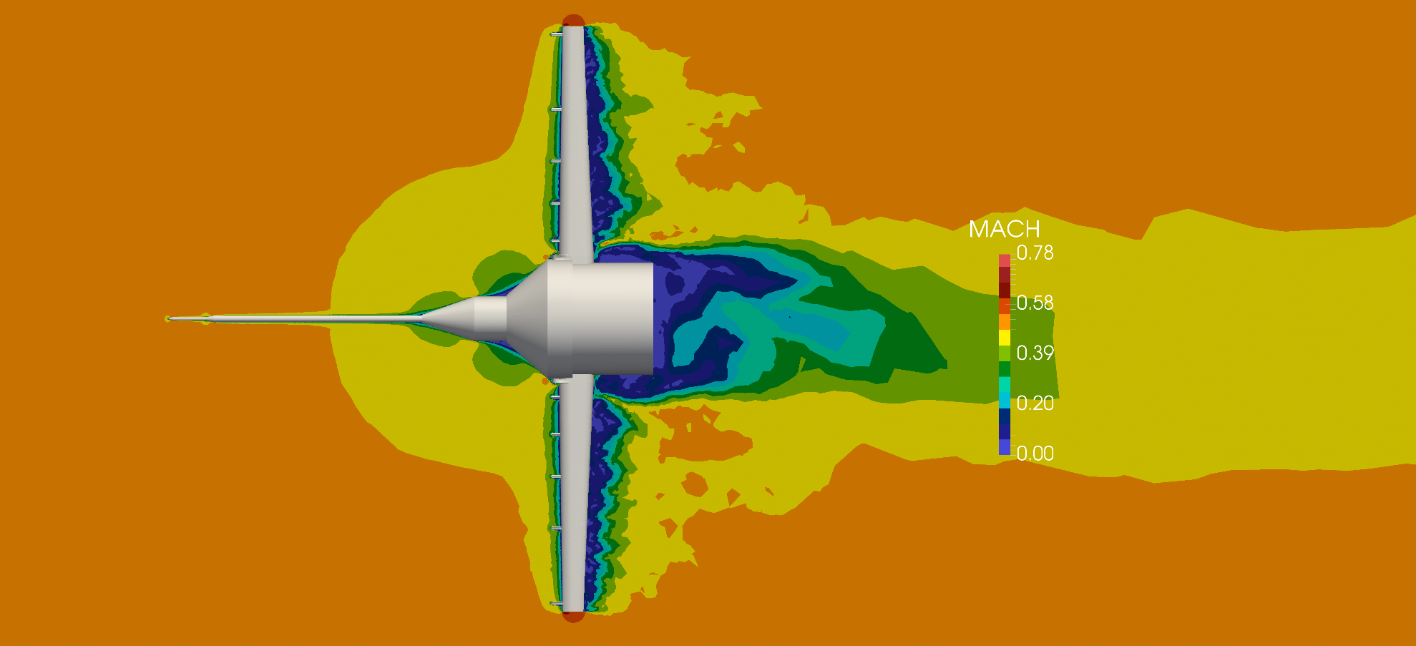
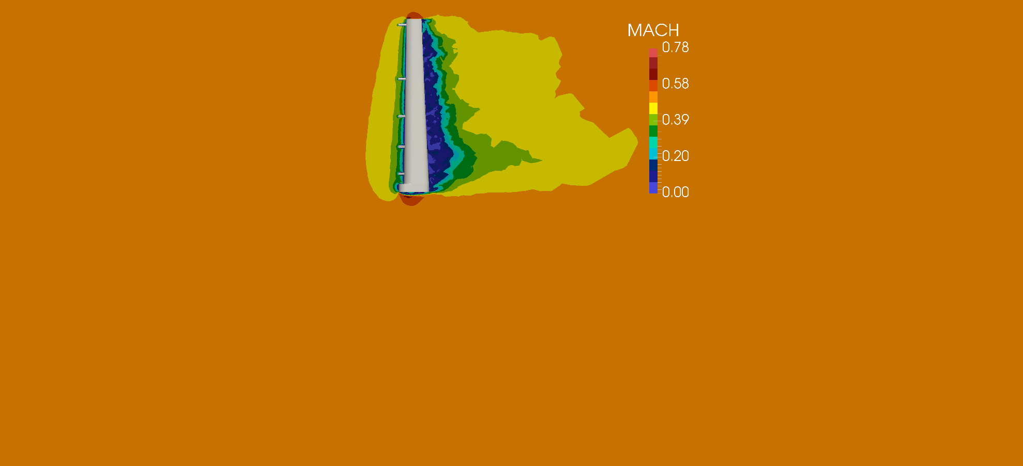
Five-Hole Probe: Results

Slide 18

Five-Hole Probe: Results

Slide 19
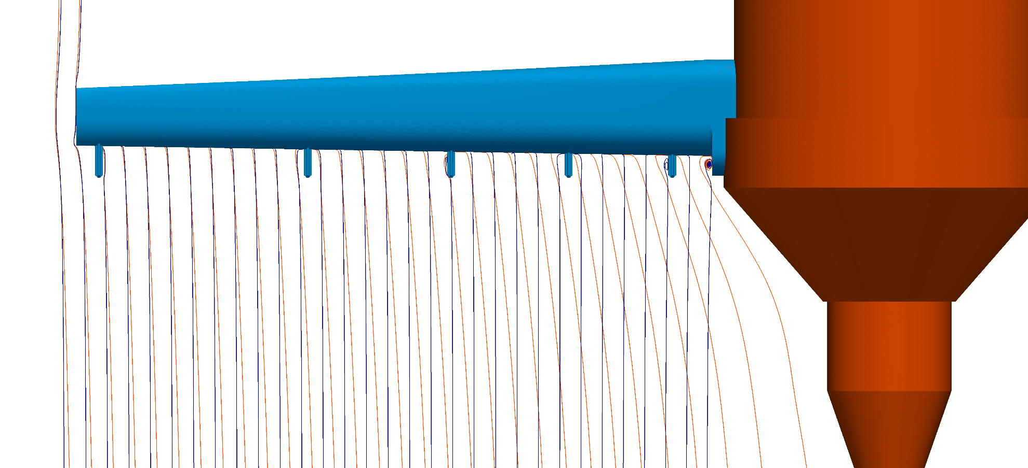
Five-Hole Probe: Results

